Slide 1
Leveraging Non-Traditional Lenders as an Origination Strategy for Reaching Underserved Borrowers
INTERNATIONAL HOUSING FINANCE PROGRAM
WHARTON BUSINESS SCHOOL, PHILADELPHIA, PA.
JUNE 2011

Slide 2
MEXICO´S HOUSING MARKET (AL)
SGA
FE
CAPITAL MARKETS
INFONAVIT
BANK
PUBLIC EQUITY
FOVISSSTE
NON BANK-BANK
STRUCTURED DEBT
SHF
CORPORATE DEBT
CONAVI
FUNDS
land developer (LAND)
contractor (BUILD)
real estate agent (SELL)
Individual home buyer
HOUSING PROCESS
SGA: Sponsored Government Agency, FE: Financial Entity

Slide 3
HOW SUCCESFULL HAVE WE BEEN? Housing-related financing “actions”
(23%)
“Progama de labores 2011”. CONAVI

Slide 4
HOW SUCCESFULL HAVE WE BEEN? Infonavit Mortgages
INFONAVIT (2009, 2010, 2011, 2012)

Slide 5
KEY DRIVERS Success Formula
MONEY SUPPLY
NON-BANK BANKS
MONEY DEMAND
DEBT CAPITAL MARKETS
BANK
INDIVIDUALS - MORTGAGES
SGA
NON BANK-BANK
DEVELOPERS – CONSTRUCTION LOANS
FE
HIGH LEVELS OF MONEY SUPPLY FROM SGA
HIGH LEVELS OF PRODUCT DEMAND STEMMING FROM HIGH HOUSING DEFICIT
LOW LEVELS OF COMPETITION
NON-REGULATED ENVIRONMENT → HIGH GROWTH RATES

Slide 6
KEY DRIVERS Sustainability
MONEY SUPPLY
NON-BANK BANKS
MONEY DEMAND
MARKET RISK
OPERATIONAL RISK
CREDIT RISK
DURATION
HEDGING
PASSTHROUGH STRUCTURES
SCALABILITY
TECHNOLOGICALY DEPENDANT
HIGH CORPORATE GOVERNANCE STANDARDS
LOAN ORIGINATION POLICIES
CREDIT STANDARDS
SUSTAINABLE BUSINESS MODEL → TIME TESTED

Slide 7
KEY LESSONS
SCALABILITY
BUSINESS MODEL WITH INCREMENTAL FIXED COSTS
MARGINAL COST FOR THE ACQUISITION OF A NEW CUSTOMER → 0
TECHNOLOGY
HIGH AND CONTINOUS INVESTMENT IN TECHNOLOGY
ADEQUATE SOLUTIONS FOR TARGET SEGMENT
THINK AHEAD OF THE TECHNOLOGY CURVE
CORPORATE GOVERNANCE
BOARD INDEPENDENCE
APPROPIATE COMMITTEE DESIGN AND OPERATION
CHECKS & BALANCES
SUSTAINABLE BUSINESS MODEL → TIME TESTED

Slide 8
HOW SUCCESFULL HAVE WE BEEN?
Non- bank banks reduced market participation in mortgage lending from 22% to 7% and construction lending from 39% to 15%;
“In Mexico, housing finance was not interrupted during the economic deaceleration (2008-2009), SGA and banks maintained open credit channels (selectively), if at all, the “brake” came from diminishing demand, not credit availability”
“Progama de labores 2011”. CONAVI

Slide 9
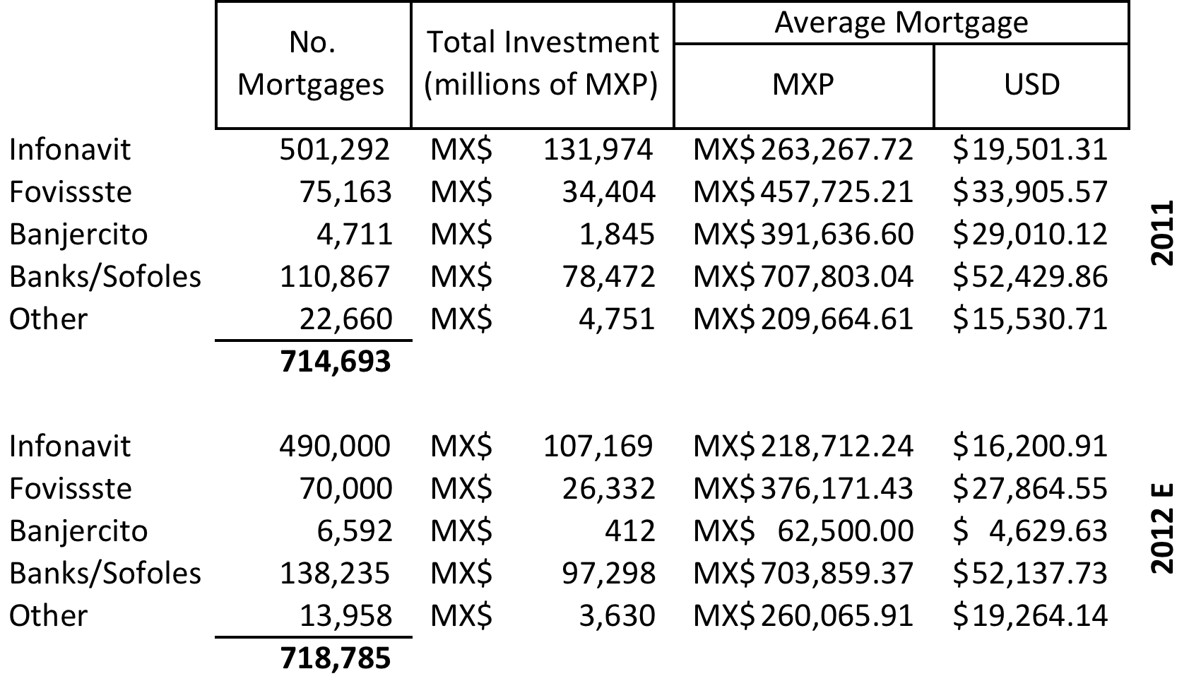
HOW SUCCESFULL HAVE WE BEEN?
We have not been successful in appropriately targeting the lowest income segment
Mexican Housing Day 2012. CONAVI

Slide 10
The Good
During 2011, Mexico was able to provide over 1 MM housing finance related “actions”, most of them in the low income segment;
Housing finance proved to be a fundamental motor in the economy, providing not only job growth, but an increase in internal savings as well, luring FDI and domestic “big-boy” investors.
Lending to the BoP proved to be profitable and achievable at a massive scale.
Strong signs of recovery across the board
BoP: Base of the Pyramid

Slide 11
The Bad
Deregulation was abused by some and consequences were not shared equally;
Free markets did not truly evolve (government paternalism prevailed – politics won);
Data was limited, not equally distributed and flawed;

Slide 12
The Ugly
Mexico has lost over half of its developers.
Investor confidence has been lost in the housing finance industry; government sponsorship has taken over what was once dominated by private investors.
The informal sector which constitutes a large portion of the BoP has been excluded from any type of housing initiative. The largest demand has no supply.
Middle sector demand has been satisfied but no important initiative has been implemented in the last 3 years for the low income sector.
BBVA Bancomer 2010 Vivienda

Slide 13
Lessons Learned SERVICING
Mortgage lending in the low-income sector is PRIMARILY and foremost a servicing/collections business;
Servicing platforms need to be robust, IT intensive, scalable and designed “ad-hoc” to the native servicing market;
Servicing capillarity is obtained through physical reach;
Collection must be performed according to the needs and requirements of the borrowers, not of the regulators or investors.
Good origination is key to future credit servicing performance

Slide 14
Lessons Learned CREDIT
BoP lending must be massive, so credit analysis strategy must be non-traditional;
Credit scoring helps, but data sources must continuously be questioned and analyzed;
Underlying house mortgage guarantee at high LTV is no substitute for good credit and payment expectations from the borrowers;
Credit analysis must not stop at origination but be the foundation for servicing/collections.
High quality data is essential for future strategy, applicable to CREDIT, SERVICING and FINANCE.

Slide 15
Lessons Learned FINANCE
Traditional models from developed economies are data based….good, historical data is required for their use, otherwise they DO NOT work; extrapolation is not a solution;
An investor-driven market require sound and solid corporate practices, corporate governance and RULE of LAW;
Investor paternalism is a short-term answer to a long term housing strategy; government actions should be targeted to bringing investor confidence by solving problems at their foundation, not at the top (quick fix).
During 1Q11, SGA programs contracted up to 15% whereas non-SGA programs have increase by up to 25%.
BBVA Bancomer 1Q11. Vivienda. Credito y Financiamiento
Percentages are yearly figures.

Slide 16
Were do we go from here?
Build a model to service the BoP:
HALF OF THE WORLD POPULATION IS FINANCIALLY EXCLUDED
Credit practices should evolve to tend the informal sector, new practices should be analyzed;
Underlying mortgage guarantees in the BoP are not sufficient → evolve to the use of “social” guarantees;
Successful housing finance is the result of actions that take place during a considerable length and should not be dealt with short-term politics. How interrelated should housing be tied to politics?
Mckinsey&Co. Full Financial Inclusion, an SCP analysis. 2010

Slide 17
Were do we go from here?
Housing Deficit
8.9 MM
100%
Economically Active Population
8.08 MM (90.3%)
Payroll Employee
6.35 MM (70.9%)
Non-payroll Employee
1.73 MM (19.4%)
Non-economically Active Population
0.87 MM (9.7%)
Payroll Employee
0.01 MM (0.1%)
Non-payroll Employee
0.86 MM (9.6%)
Affiliated
2.25 MM (25.1%)
Non-affiliated
4.10 MM (45.8%)
Affiliated
0.05 MM (0.5%)
Non-affiliated
1.69 MM (18.8%)
In 2011, 5.79 MM (64.6%) of the total housing deficit is represented by economically active individuals who are not affiliated to the country’s social security program, by 2012 total Non-affiliated individuals were estimated at 5.9 MM
SHF: 2011, 2012

Slide 18
Think “out of the box”
Mortgage guarantee with high LTV is not sufficient in low income sector and high LTV loans.
“Social” guarantees:
Best practices in micro-lending
Credit Bureau
Group solidarity (Condominium rule enforceability)
Rent-to-Own programs

Slide 19
Mark D. Zaltzman
zaltzmam@georgetown.edu

Slide 20
Appendix

Slide 21
Target Market Specialization…what does it do for us?
Specialization has both significant benefits and disadvantages
 | Banks | Non Traditional Lenders
Average Loan Size | US$70,000 | US$25,000
Distribution network | Bank branches | Developers, real estate brokers, branches
Origination basis | Multiproduct | Specialized
Developer relationship | Focused on retail product | Construction loan → Individual loan
Borrower’s income segment | Middle-high | Low-middle
Product distribution | Retail | Wholesale& retail

Slide 22
Origination
High percentage of borrowers consider non-bank financial intermediary as their first contact with the formal financial sector;
Non-formal segment cannot produce formal income evidence
Non- Bank
Financial Intermediary
Bank
Payroll evidence (employed)
Formal
Income tax (self-employed)
Potential borrower
Income & expense evidence
Informal
Savings

Slide 23
Origination Process
The mortgage origination and servicing processes in Mexico are similar to the US processes.
During the early 1960’s most Latin-American countries received technical aid to start their own Savings & Loans systems, this set the basis for their mortgage operations.
Origination
Loan
application
Loan
processing
Loan
underwriting
Loan
closing
Loan
post closing
Servicing
Payment
reception
Collection
Record
maintenance
Investor
reporting
Loan
payoff

Slide 24
Credit Bureau
Non-bank financial intermediary’s loan application requests credit bureau information;
Historical CB information is critical to produce a reliable credit scoring model since origination information in the informal market is unreliable and at times unavailable;
Behavior Score is best alternative in informal sector
NB FI origination branch
Credit Bureau
SGA Credit
Score
NB FI Credit Score
Request Funds
NB FI – Non bank bank financial intermediary (SOFOM & SOFOM figure used in Mexico.
SGA – Sponsored Government Agency such as SHF

Slide 25
Informal Sector
Informal sector in Mexico is larger and economically as important as the formal sector
Informal sector clients show income evidence from various sources (formal & informal)
Socioeconomic investigation provides 3rd party overview of income sources and recommendations
Show me how much you spend & I will tell you how much you earn !!
Helps family structure expenses and create a savings/expense culture
Income & expense evidence
Savings program that demonstrates payment capacity and timeliness;
Stresses payment capacity since rent payments are still in effect;
Institute savings culture
Savings

Slide 26
Distribution Network
There are two distinct sources of mortgages
Wholesale mortgages →developers with/without construction financing attached. All mortgages are for the purchase of new homes. Only low-income segments.
Retail segment. → Walk-ins to branches or through the broker network. New & used housing. Mostly middle & high income segments.
Retail product has on average an origination balance 50% larger than wholesale product which compensates for higher origination costs (fees).
Compensation/Benefit
Wholesale
Developers
Mortgage price (fees & interest rate)
Non- Bank
Financial Intermediary
Retail force
Variable to retail force
Retail
Third Party brokers

Slide 27
Collection Effort
Treat collection as a service, not an unwanted obligation
Know your borrower
Non-payment is not only the borrowers problem but also de lenders.
Forbearance vs. Foreclosure, critical in economic downturn cycles or extraordinary events.
 | Service | Location | Forbearance | Foreclosure
Non- Bank Financial Intermediary | Provide borrowers with a variety of alternatives of payment | Targeting low-income segments; Easy Access to branches from home development | Emphasis on forbearance to avoid loss severity → small loans | High incentive for expedite foreclosure to claim on mortgage insurance
Bank | Payment only in branches; Requires bank account to collect from | Targets middle-high income geographic locations | Totally outsourced Incentives for forbearance & foreclosure are lost and not allocated to origination division

Slide 28
Collection Effort
Identify your borrowers status early on and act upon it.
Identify willingness to pay vs. ability to pay.
Four basic stages that serve as transition points between non-payment behavior:
CURRENT LOAN PORTFOLIO REQUIRES ONLY PAYMENT RECEIPT COLLECTION EFFORT PROVIDED BY EITHER THE FI OR THROUGH REFERENCED DEPOSITS AT BANKS
ADMINISTRATIVE PORTFOLIO IS ASSIGNED TO THE FI’S INTERNAL LOAN RECOVERY PERSONNEL AND CALL-CENTERS. EARLY WARNING CALL TOGETHER WITH HOUSE VISITS REPRESENT MAJORITY OF CONTACT WITH BORROWER
EXTRAJUDICIAL PORTFOLIO IS SERVICED BY EXTERNAL COLLECTORS, MAINLY LAWYERS. COLLECTION EFFORT IS MORE AGGRESSIVE WITH LEGAL ACTION IMMINENT.
JUDICIAL PORTFOLIO OUTSOURCED TO LEGAL STAFF DEDICATED TO FORECLOSE.
Loan Tenure
1 - 4 months
5 - 6 months
7+ months
Current Loan
Portfolio
Administrative
Portfolio
Extrajudicial
Portfolio
JUDICIAL

